Slide 1

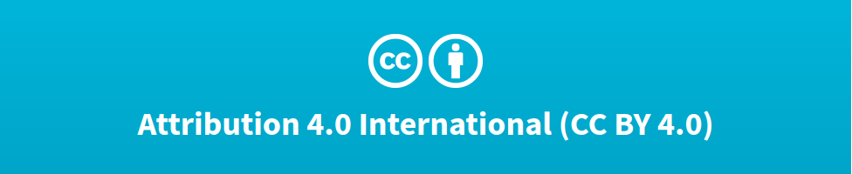

Deep Learning Design Patterns with Tensorflow 2.0
Computer Vision Workshop - AutoEncoders Version: Mar 2020
Repo: github.com/GoogleCloudPlatform/keras-idiomatic-programmer
twitter.com/andrewferlitsch

Slide 2
AutoEncoders
Overview
We will cover in this section principles and design of autoencoders.
Unsupervised Training - no human labeling (does not mean there are no labels).
DNN/CNN AutoEncoder - learn to compress/decompress a dataset
Denoising - learn to denoise (image) data.
Pre-text Tasks - pre-training a mobile for learning essential features.

Slide 3
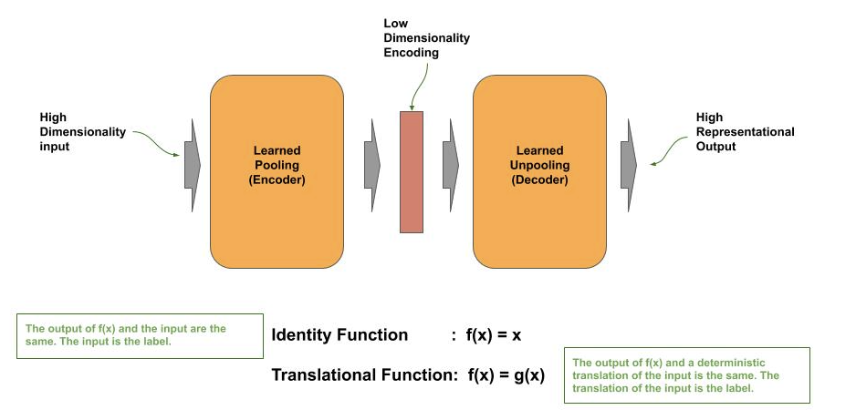
Basic Principle

Slide 4
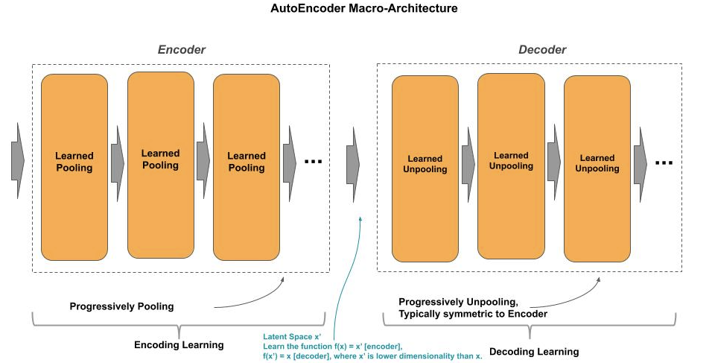
Architecture
The encoder performs representational learning on the input to learn a function f(x) = x’.
x’ is referred to as the latent space, which is the learned representation from x at a lower dimensionality.
The decoder performs transformational learning from the latent space to perform some form of reconstruction of the original image.

Slide 5
Identity Function
Autoencoder learns the identity function f(x) = x.
Since the latent space x’ is of lower dimensionality, we typically refer to this form of an autoencoder as learning the optimal way to compress images in a dataset (encoder) and then decompress the images (decoder).
That is, the dataset represents a distribution, and for that distribution the autoencoder learns the optimal method to compress the images to a lower dimensionality and learns the optimal decompression to reconstruct the image.
The optimal method to compress/decompress is specific to the distribution.

Slide 6
Encoder as DNN
Below is an example implementation of the encoder for an autoencoder to learn the identity function, where we progressively pool the number of nodes (hidden units) through the parameter layers. The output from the encoder is the latent space.
def encoder(x, layers): ''' Construct the Encoder x : input to the encoder layers: number of nodes per layer ''' x = Flatten()(x) for layer in layers: n_nodes = layer['n_nodes'] x = Dense(n_nodes)(x) x = BatchNormalization()(x) x = ReLU()(x) return x
Progressive Node (Unit) Pooling
Latent Space

Slide 7
Decoder as DNN
Below is an example implementation of a decoder for an autoencoder where we progressively unpool the number of nodes (hidden units) through the parameter layers. The output from the decoder is the reconstructed image.
For symmetry with the encoder, we iterate through the layers parameter in the reverse direction.
def decoder(x, layers, input_shape): ''' Construct the Decoder x : input to the decoder (encoding) layers: nodes per layer ''' for _ in range(len(layers)-1, 0, -1): n_nodes = layers[_]['n_nodes'] x = Dense(n_nodes)(x) x = BatchNormalization()(x) x = ReLU()(x) units = input_shape[0] * input_shape[1] * input_shape[2] x = Dense(units, activation='sigmoid')(x) outputs = Reshape(input_shape)(x) return outputs
Progressive Node (Unit) Unpooling
Image Reconstruction

Slide 8
Training
Node Pooling Configuration
layers = [ {'n_nodes': 256 }, { 'n_nodes': 128 }, { 'n_nodes': 64 } ] inputs = Input((28, 28, 1)) _encoder = encoder(inputs, layers) outputs = decoder(_encoder, layers, (28, 28, 1)) ae = Model(inputs, outputs) ae.compile(loss='binary_crossentropy', optimizer='adam', metrics=['accuracy']) ae.fit(x_train, x_train, epochs=10, batch_size=32, validation_split=0.1, verbose=1) ae.evaluate(x_test, x_test)
Construct
AutoEncoder
Training images are both the input and labels.

Slide 9
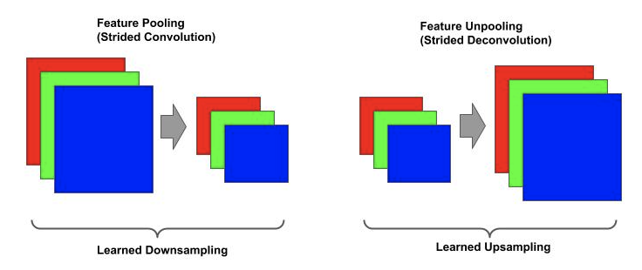
Convolutional AutoEncoder
AutoEncoders using nodes (hidden units) are computationally expensive for larger images. For larger images, deep convolutional (DC) autoencoders are more efficient. Instead of learning to (un)pool nodes, they learn to (un)pool feature maps using convolutions in the encoder and deconvolutions, also known as transpose convolutions, in the decoder.

Slide 10
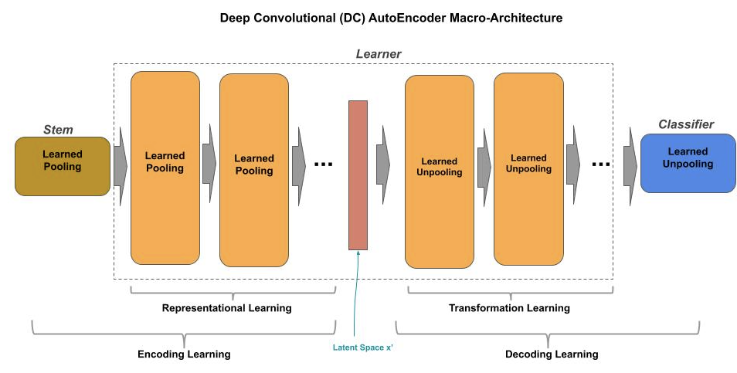
Architecture
The macro architecture for a deep convolutional autoencoder (DC-AutoEncoder) can be decomposed as:
Stem component - does coarse level feature extraction.
Learner - does representational and transformation learning.
Classifier - does projection and reconstruction.

Slide 11
Encoder as CNN
The encoder in a deep convolutional autoencoder progressively reduces the number of feature maps (feature reduction) and the size of the feature maps (feature pooling) using strided convolutions.
def encoder(inputs, layers): """ Construct the Encoder inputs : the input vector layers : number of filters per layer """ x = inputs for n_filters in layers: x = Conv2D(n_filters, (3, 3), strides=(2, 2), padding='same')(x) x = BatchNormalization()(x) x = ReLU()(x) return x
Progressive Feature Pooling
Latent Space

Slide 12
Decoder as CNN
The decoder in a deep convolutional autoencoder progressively increases the number of feature maps (feature expansion) and the size of the feature maps (feature unpooling) using strided deconvolutions (transpose convolutions). The last unpooling layer projects the feature maps according to the reconstruction task.
def decoder(x, layers): """ Construct the Decoder x : input to decoder layers : the number of filters per layer (in encoder) """ for _ in range(len(layers)-1, 0, -1): #A n_filters = layers[_] x = Conv2DTranspose(n_filters, (3, 3), strides=(2, 2), padding='same')(x) x = BatchNormalization()(x) x = ReLU()(x) x = Conv2DTranspose(3, (3, 3), strides=(2, 2), padding='same')(x) x = BatchNormalization()(x) x = ReLU()(x) return x
Progressive Feature Unpooling
Image Reconstruction

Slide 13
Sparse AutoEncoders
The size of the latent space is a trade-off.
If too big, then it may overfit to the representational space off the training data and not generalize.
If too small, then it may underfit that we are unable to perform the transformation and reconstruction for the designated tasks (e.g.,identity function).
We want to find that “sweet spot” between the two.

Slide 14
Sparse AutoEncoders
Adding a sparsity constraint helps an AutoEncoder to not overfit.
The concept of the sparsity constraint is to:
Limit the activation of the neurons on the bottleneck layer that outputs the latent space.
This acts as both a squashing function and a regulazier, which helps the autoencoder generalize the latent space representation.

Slide 15
Sparsity Constraint
In TF.Keras, we add the sparsity constraint with the activity_regularizer parameter to the last layer in the encoder. The value specifies the threshold for which an activation is within +/- of zero is changed to zero. A typical value is 1e-4.
L1
Regularizer
from tensorflow.keras.regulaziers import l1 def encoder(inputs, layers): x = inputs last_filters = layers.pop() for n_filters in layers: x = Conv2D(n_filters, (3, 3), strides=(2, 2), padding='same')(x) x = BatchNormalization()(x) x = ReLU()(x) x = Conv2D(last_filters, (3, 3), strides=(2, 2), padding='same', activity_regularizer=l1(1e-4))(x) x = BatchNormalization()(x) x = ReLU()(x) return x
Latent Space
Regularization

Slide 16
Denoising AutoEncoder
An autoencoder can be to trained as an image denoiser. Given a noisy image, to output a denoise version of the image.
Think of it as learning the identity function with some noise. In this equation, x is the image and e is the noise. The function learns to return x.
f(x + e) = x

Slide 17
Train Denoiser
We don’t need to change the autoencoder architecture for this purpose, but instead change our training data, as follows:
Construct a random generator that will output a random distribution with the value range of the noise you want to add to the training (and test) images.
When training, add the noise to the training data.
For labels, use the original images.
noise = np.random.normal(loc=0.5, scale=0.5, size=x_train.shape) x_train_noisy = x_train + noise model.fit(x_train_noisy, x_train, epochs=epochs, batch_size=batch_size, verbose=1)

Slide 18
Pre-Text Tasks
Autoencoders can be trained without labels to learn feature extraction of essential features, which we can repurpose beyond the examples given so far: compression and denoising.
For imaging, we want our models to learn the essential features of the data, and not the data itself. This enables the models to not only generalize to unseen data in the same distribution, but to be better able to correctly predict when there is a shift in the input distribution (data drift) after it is deployed.
For autoencoders to work, they have to learn how the pixels are correlated -- i.e., representational learning. The more correlated, the more likely the relationship will show up in the latent space representation, and the less correlated the more likely it will not.

Slide 19
Pre-Text Tasks
Autoencoders can be trained without labels to learn feature extraction of essential features, which we can repurpose beyond the examples given so far: compression and denoising.
For imaging, we want our models to learn the essential features of the data, and not the data itself. This enables the models to not only generalize to unseen data in the same distribution, but to be better able to correctly predict when there is a shift in the input distribution (data drift) after it is deployed.
For autoencoders to work, they have to learn how the pixels are correlated -- i.e., representational learning. The more correlated, the more likely the relationship will show up in the latent space representation, and the less correlated the more likely it will not.

Slide 20
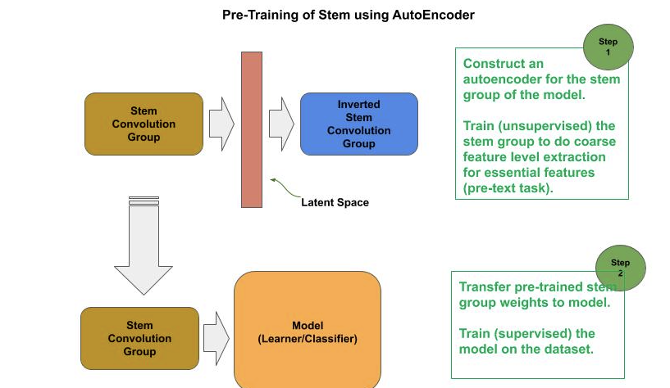
Pre-Text Task Training
In this example we use an autoencoder approach to train the stem convolutional group to learn to extract the essential coarse level features (i.e., coarse feature extraction), before training the model on the dataset.
Do warmup (supervised) training on the target model for numerical stabilization.
Construct an autoencoder consisting of the stem group from the model as the encoder,
and inverted stem group as the decoder.
Transfer the numerically stabilized weights from the target model to the encoder in the autodecoder.
Train (unsupervised) the autoencoder on the pre-text task (e.g., compression, denoising).
Transfer the pre-text task trained weights from the encoder of the autoencoder to the target model.
Train (supervised) the target model.

Slide 21
Pre-Text Task Training
The output from a stem convolutional group will be larger than the input. That is, while we do either a static or feature pooling on the channels, we increase the number of overall channels. For example, we might use pooling to reduce the channel size to 25% or even just 6%, but we increase the number of channels from three (RGB) to something like 64.
Thus, the latent space is now larger than the input and much more prone to overfitting.
For this particular purpose, we build a sparse autoencoder to offset the potential to overfit.
def stem(inputs): x = Conv2D(64, (5, 5), strides=(2, 2), padding='same', activity_regularizer=l1(1e-4))(inputs) x = MaxPooling2D((2, 2), strides=(2, 2))(x) return x def inverted_stem(inputs): x = UpSampling2D((2, 2))(inputs) x = Conv2DTranspose(3, (5, 5), strides=(2, 2), padding='same')(x) return x inputs = Input((128, 128, 3)) _encoder = stem(inputs) _decoder = inverted_stem(_encoder) model = Model(inputs, _decoder)

Slide 22
AutoEncoders - Lab Exercise #XX
Optional Code Lab - Get Familiar with AutoEncoders
Deep Learning Design Patterns - Workshop - Chapter 5.ipynb

